Slide 1
MINI PROJECT: PERFORMING EDA ON A DATASET
SUBMITTED BY : SUBMITTED TO:
DWARAPU KOMAL HARSHA CYPHER SCHOOL

Slide 2
1. WHAT THE DATASET IS ABOUT? WHAT TYPE OF INFORMATION CAN YOU GATHER BY SIMPLY READING THE COLUMN NAMES AND THE VALUES CONTAINED IN THE COLUMNS?
Based on the attributes you provided and the attribute names can provide some hints about the potential domain or theme of the dataset. Here are some observations based on the attribute names:
1.Year_Birth: This attribute appears to represent the birth year of individuals.
2. Income: This attribute likely represents the income level or financial information of individuals.
3. Education: This attribute suggests the educational background or level of individuals.
4. Marital status: This attribute indicates the marital status of individuals.
5. Kidhome: This attribute may represent the number of children at home for individuals

Slide 3
6. Teenhome: This attribute may indicate the number of teenagers at home for individuals.
7. Recency: This attribute could represent a measure of recency or time since a particular event.
8. Dt_customer: This attribute might represent the customer's registration or start date.
9. Mntwines, Mntfruits, Mntmeat, Mntfishprawn: These attributes likely represent the amounts spent on wine, fruits, meat, and fish/prawns, respectively.
10. Numdeals, Numweb, Numstore: These attributes could represent the number of deals, website visits, and store visits, respectively.
11. Accepted: This attribute might indicate whether a particular offer or proposal was accepted.
12. Z_revenue: The reviewer's estimated annual revenue and Z_costcontact: The reviewer's estimated cost per contact.

Slide 4
Based on these attributes, the dataset could potentially be related to wines Review Dataset, where demographic information, purchase behavior, and customer interactions are being studied. However, it is essential to note that these observations are speculative.

Slide 5
WHAT IS THE PERCENTAGE OF MISSING VALUES IN THE WHOLE DATASET? WHICH COLUMN HAS THE HIGHEST NUMBER OF MISSING VALUES?
Determining the percentage of missing values in a dataset and identifying the column with the highest number of missing values are crucial steps in data analysis. Let's consider a hypothetical dataset and explore these aspects.
To calculate the percentage of missing values in the whole dataset,
Count the total number of missing values in the dataset across all columns.
Calculate the total number of cells in the dataset (excluding headers).
Divide the count of missing values by the total number of cells and multiply by 100 to obtain the percentage.

Slide 6
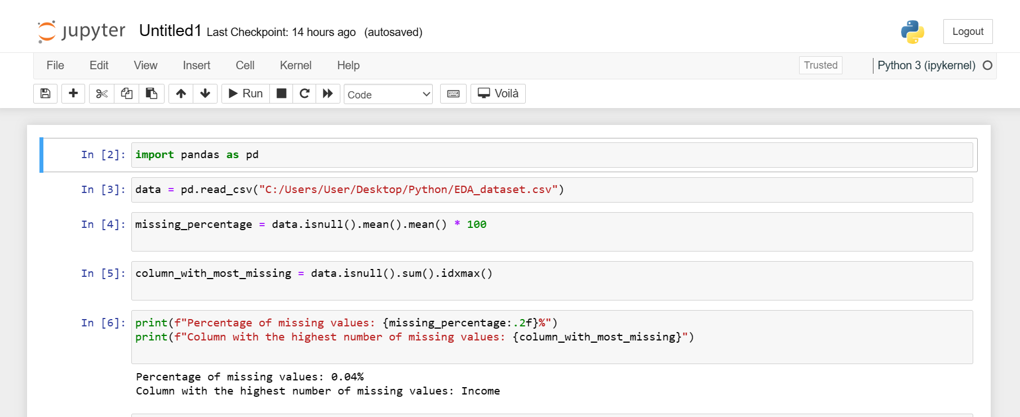

Slide 7
HOW MANY COLUMNS HAVE NOT MORE THAN JUST 1 VALUE?
Analyzing the number of columns with only one unique value in a dataset can be an important step in data exploration and quality assessment. Columns with a single value provide limited or no variation, which can be problematic for statistical analysis or machine learning tasks.
Identifying such columns helps us understand the composition and uniqueness of the dataset. It indicates that these particular features do not contribute any distinguishing information, as they possess constant values throughout the dataset. Such columns are commonly referred to as constant or quasi-constant features.

Slide 8
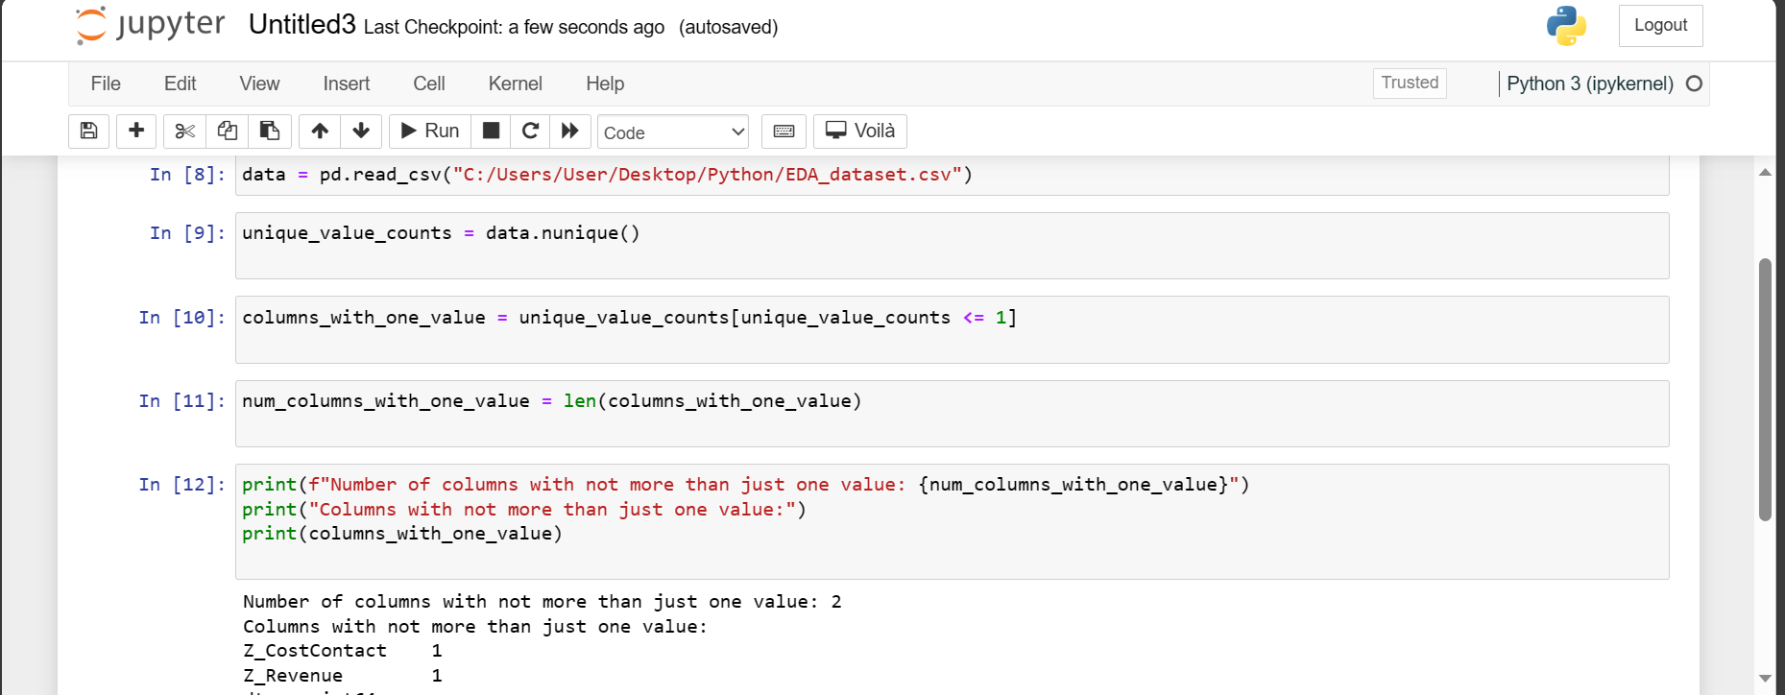

Slide 9
CALCULATE THE STATISTICAL PROPERTIES OF COLUMNS HAVING NUMERICAL VALUES AS WELL AS AT LEAST 5 UNIQUE COLUMN VALUES.
Calculating the statistical properties of columns with numerical values and at least five unique column values is an important step in data analysis. These statistical properties provide insights into the central tendency, dispersion, and distribution of the data. Let's explore this subject further.
To calculate the statistical properties of such columns, we typically consider measures such as mean, median, mode, standard deviation, minimum, maximum, and quartiles. These measures help us understand the characteristics and variability of the data.

Slide 10
Here's a general outline of the steps involved in calculating statistical properties:
Identify the columns that have numerical values and contain at least five unique values. These columns are suitable for statistical analysis.
Extract the data from these columns and store them in separate variables or arrays.
Compute the following statistical properties:
Mean: Calculate the average value of the data, which represents the central tendency.
Median: Find the middle value of the data, which separates the higher half from the lower half.
Mode: Identify the most frequently occurring value(s) in the data.
Standard Deviation: Measure the dispersion or variability of the data around the mean.
Minimum: Determine the smallest value in the data.
Maximum: Identify the largest value in the data.
Quartiles: Divide the data into four equal parts, providing insights into the distribution.
Present the calculated statistical properties for each relevant column, either in tabular form or through descriptive explanations

Slide 11
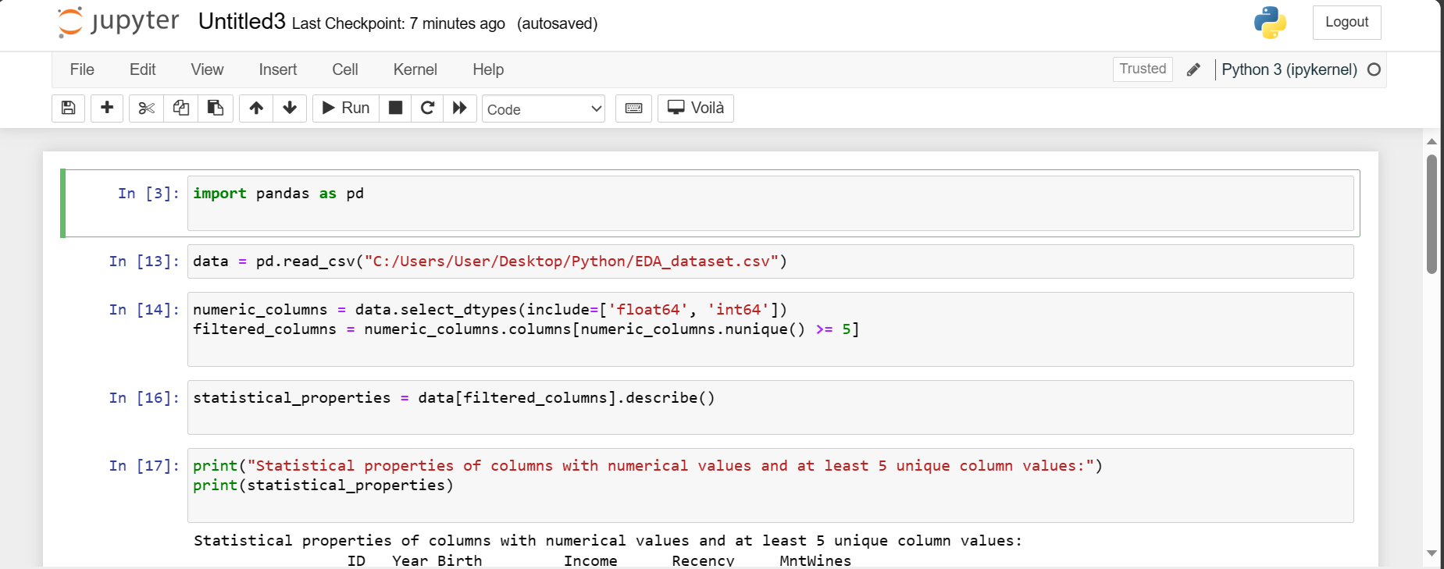

Slide 12
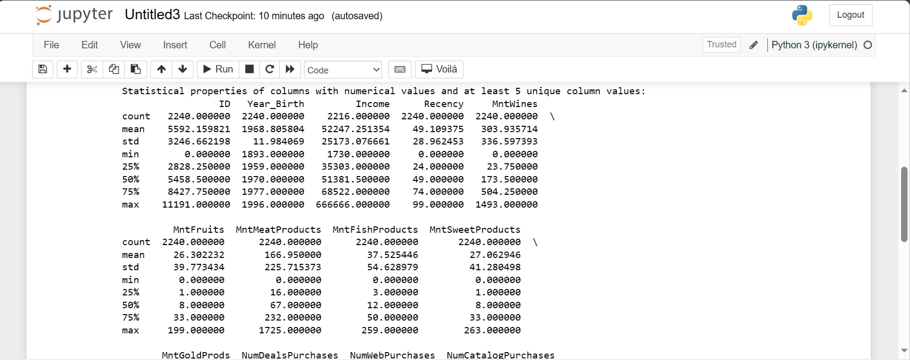

Slide 13
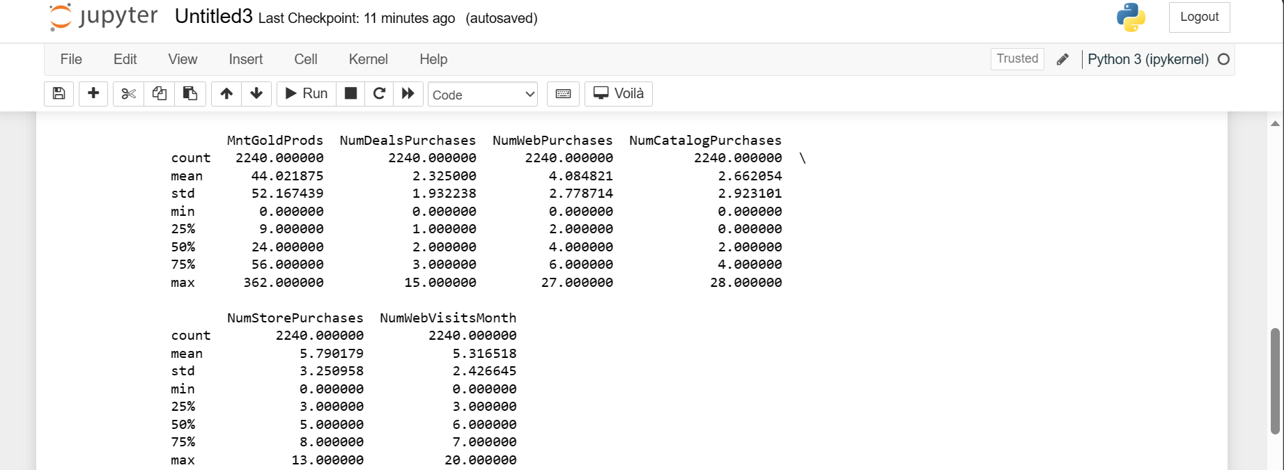

Slide 14
CREATE A BAR PLOT FOR SOME SELECTED CATEGORICAL COLUMNS
A bar plot is a great way to visualize categorical data. It is a simple and easy-to-understand chart that can be used to show the distribution of data across different categories.
To create a bar plot, you first need to select the categorical columns that you want to plot. Once you have selected the columns, you can use a plotting library like Matplotlib or Seaborn to create the plot.

Slide 15
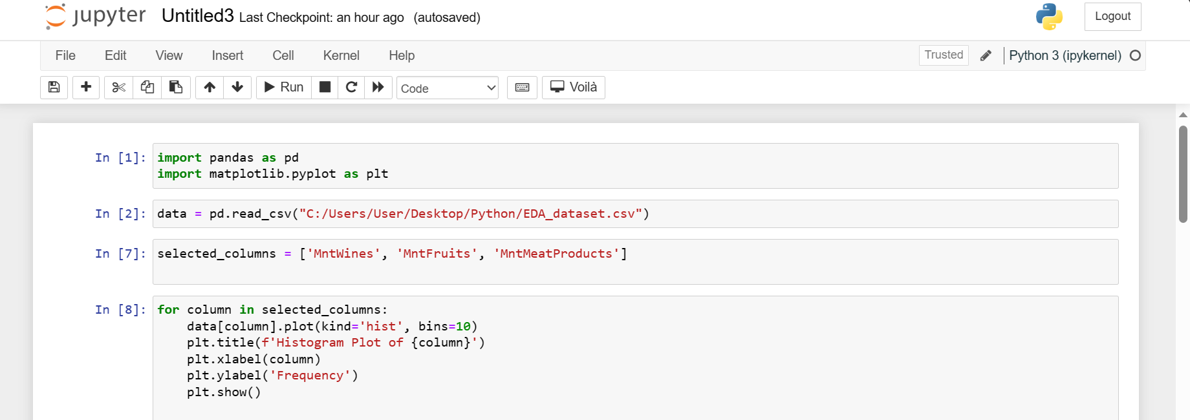

Slide 16
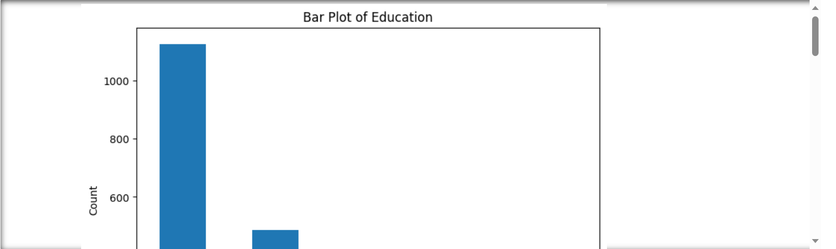

Slide 17
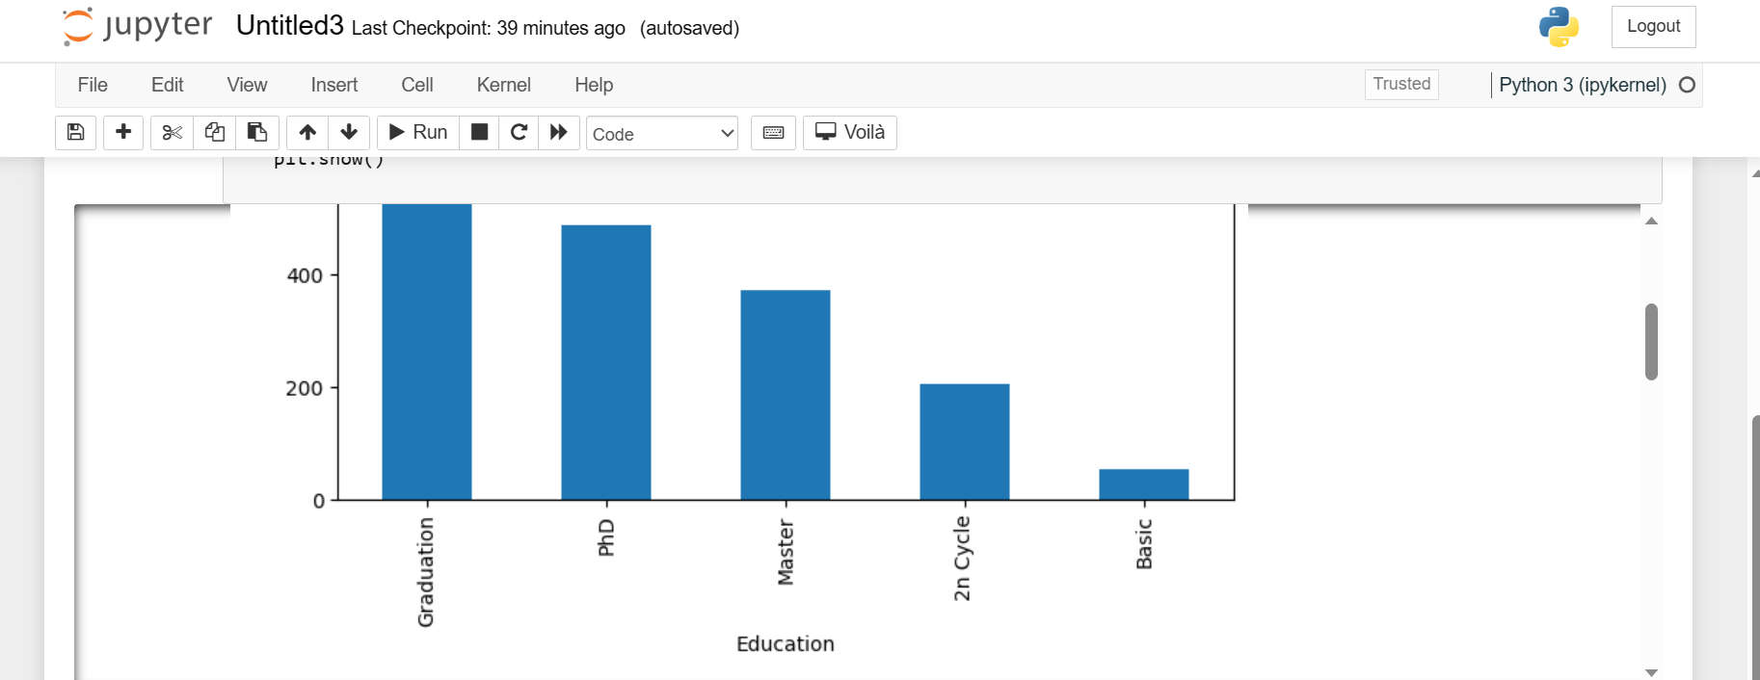

Slide 18
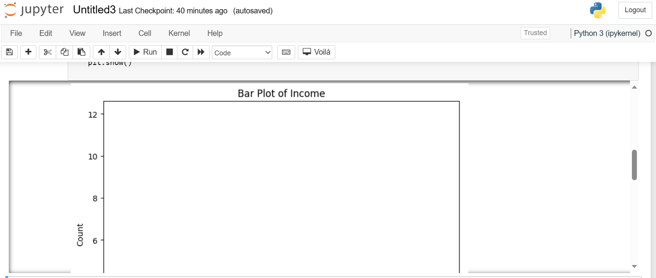

Slide 19
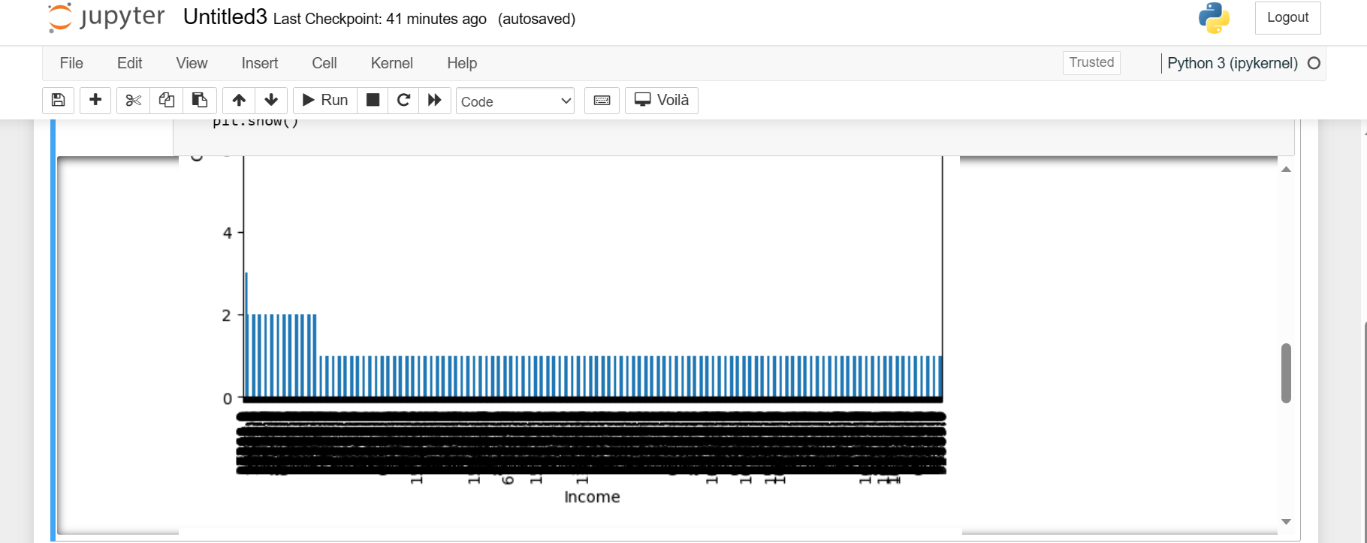

Slide 20
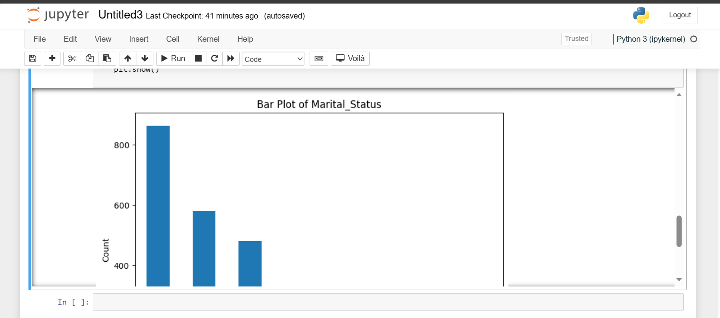

Slide 21
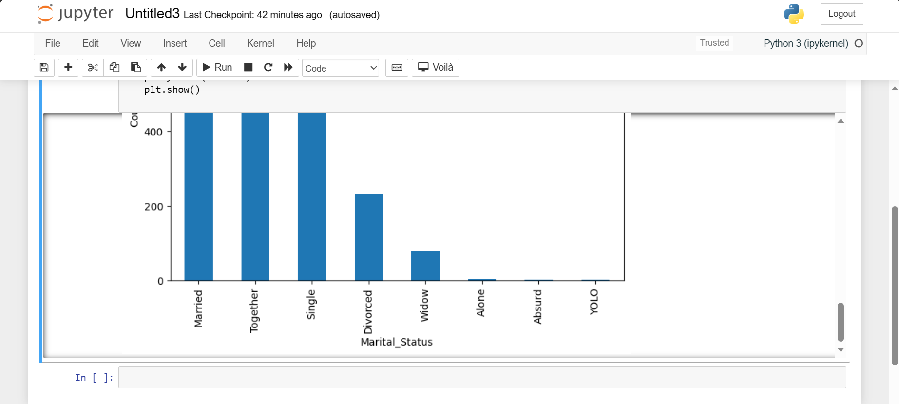

Slide 22
CREATE A HISTOGRAM PLOT FOR SOME SELECTED NUMERICAL COLUMNS.
A histogram is a graphical representation of the distribution of data. It is a bar graph where the height of each bar represents the frequency of a particular value. Histograms are a useful way to visualize the distribution of data and to identify any patterns or outliers.
To create a histogram plot for some selected numerical columns, you can use the following steps:
Import the necessary libraries, such as NumPy, Matplotlib, and Pandas.
Load the dataset into a Pandas DataFrame.
Select the numerical columns that you want to plot.

Slide 23
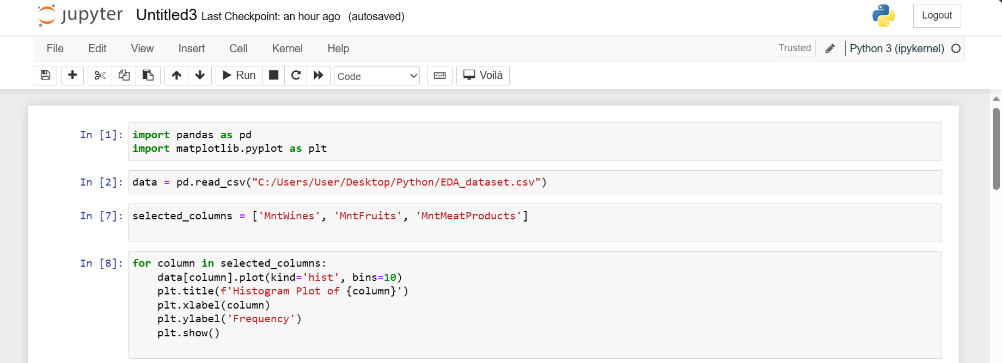
Create a histogram plot using the Matplotlib
Add a title and labels to the axes.
Show the plot.

Slide 24
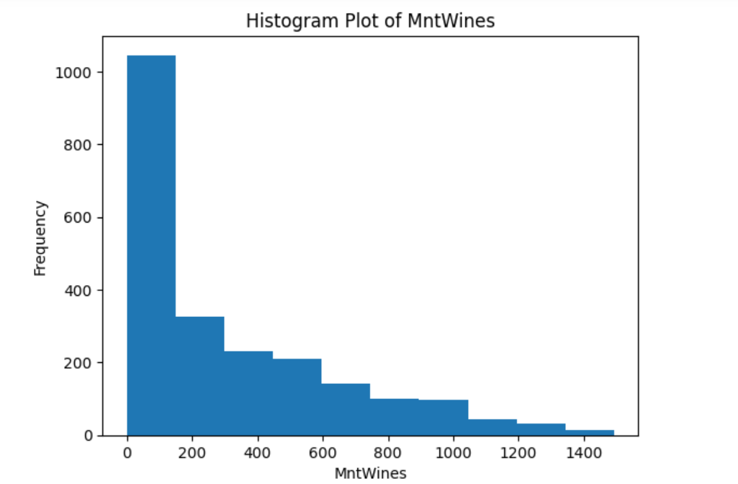

Slide 25
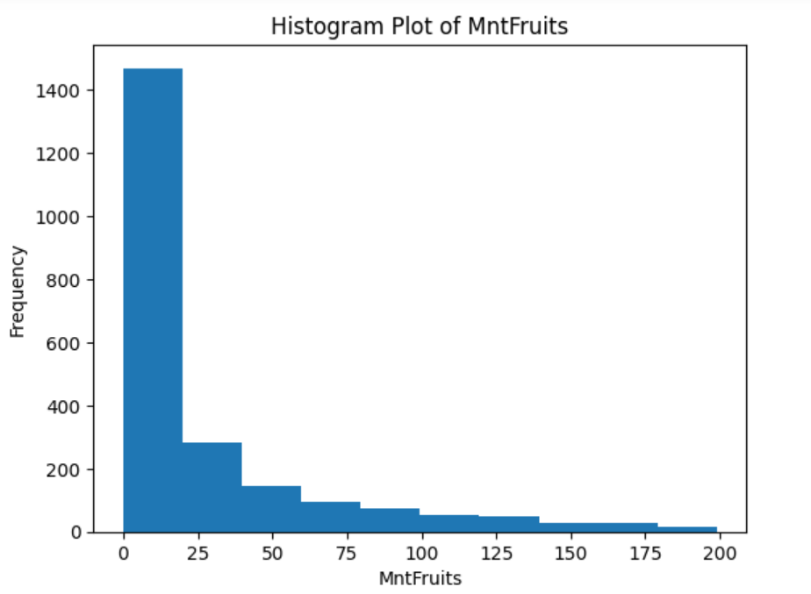

Slide 26
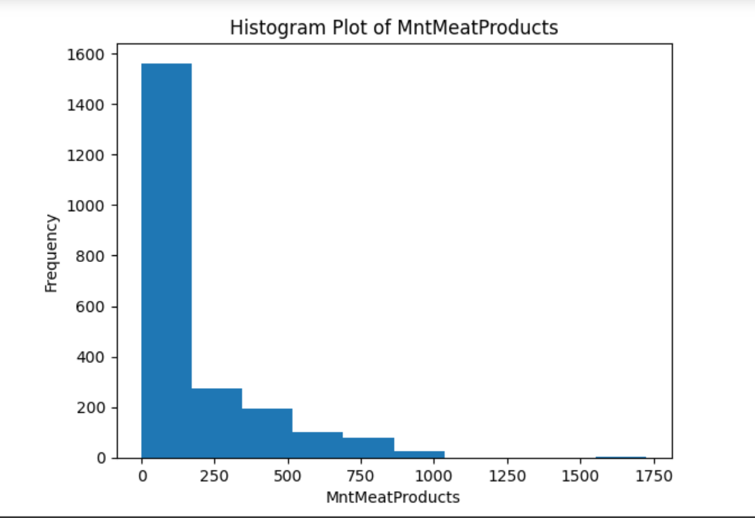

Slide 27
CREATE A PAIR PLOT FOR THE NUMERICAL COLUMNS IN THE DATASET.
A pair plot is a visualization that shows the relationship between each pair of numerical variables in a dataset. This can be a useful way to explore the data and identify any potential relationships between the variables.
To create a pair plot, you can use the pairplot() function in the Seaborn library .
This function will create a grid of plots, with each plot showing the relationship between two variables. The diagonal plots in the grid will show the distribution of each variable

Slide 28
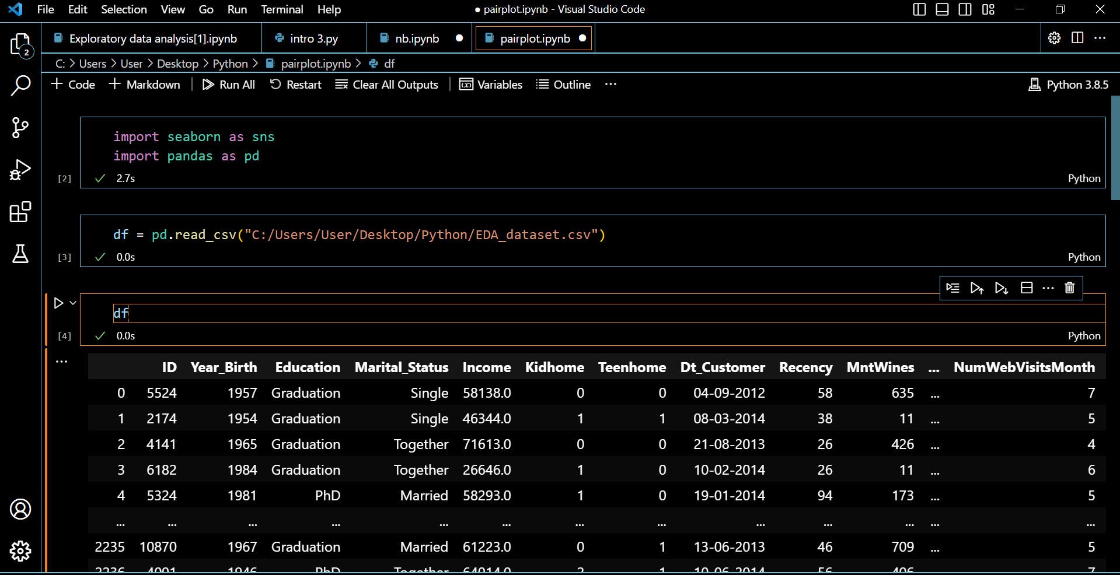

Slide 29
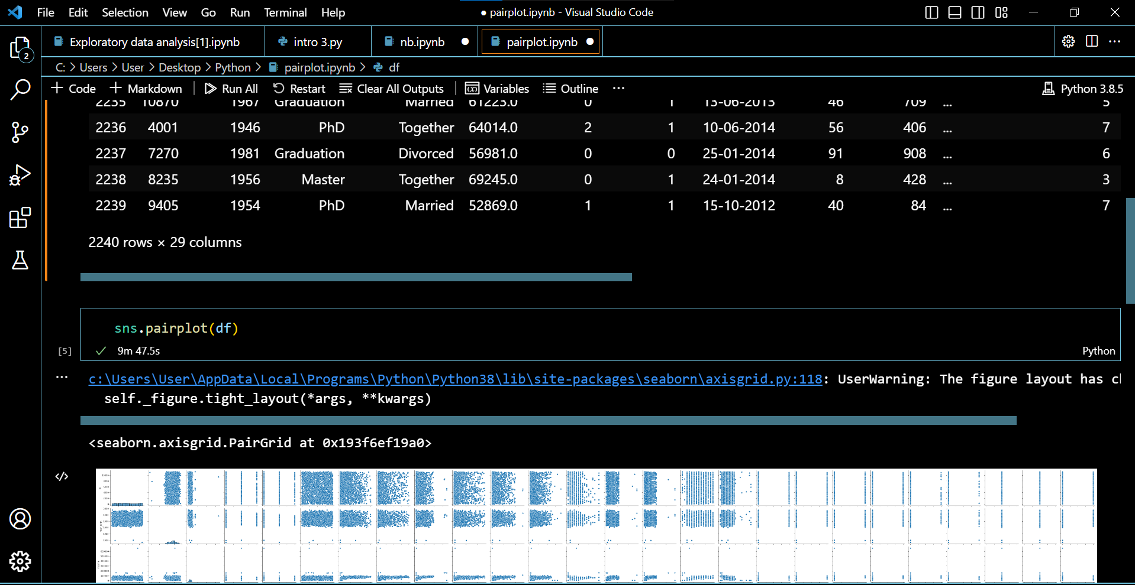

Slide 30
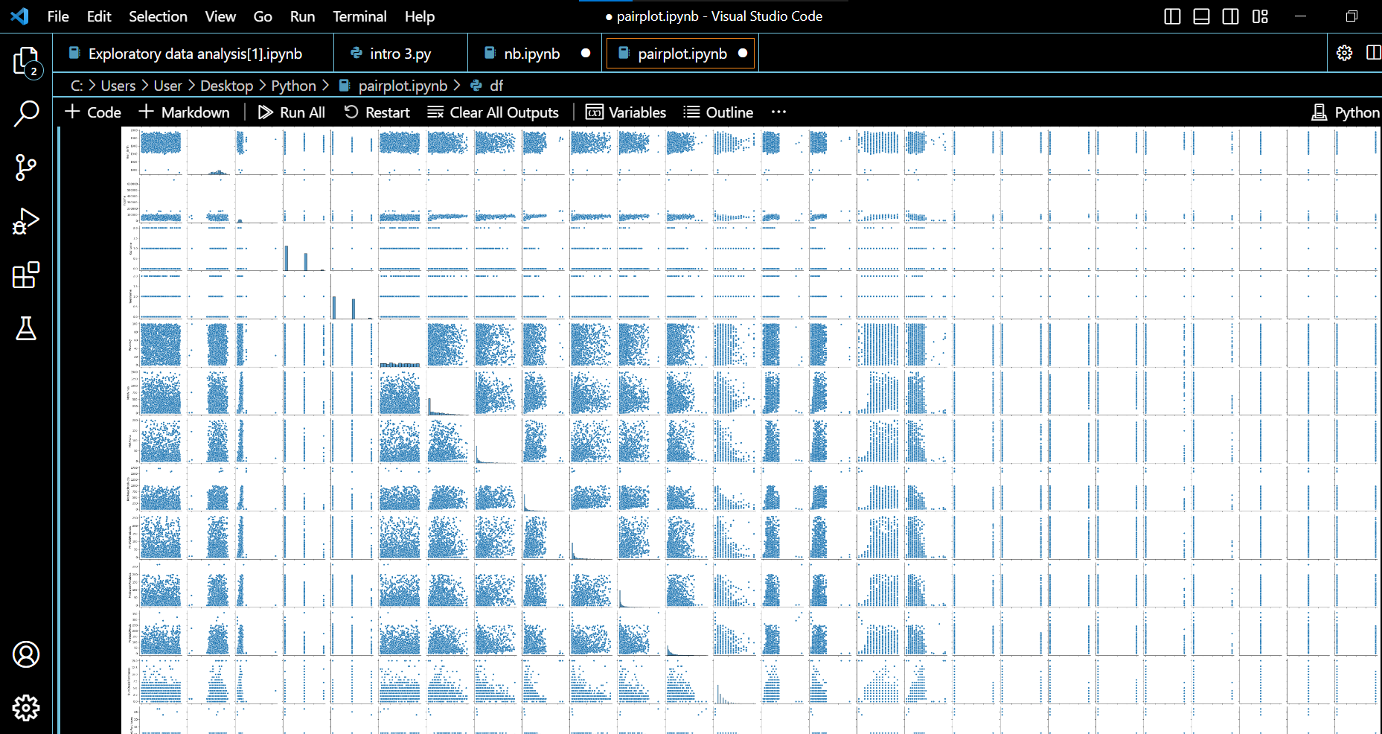

Slide 31
8. LIST DOWN THOSE PAIRS OF NUMERICAL COLUMNS HAVING THE TOP 3 POSITIVE CORRELATION VALUES. CREATE A SCATTER PLOT FOR THESE 3 PAIRS.
These correlations suggest that there is a positive relationship between the amount of money a reviewer spends on wine per month and the amount of money they spend on fruits per month, the number of wine deals they redeem, and the number of times they visit the Wine Enthusiast website.
In other words, reviewers who spend more money on wine tend to also spend more money on fruits, redeem more wine deals, and visit the Wine Enthusiast website more often.
This is not surprising, as wine and fruits are both popular beverages, and wine lovers are likely to be interested in learning about new wines and deals. Additionally, wine lovers are likely to be frequent visitors to wine websites.
As you can see, the points in all 3 scatter plots tend to cluster together, which suggests that there is a strong positive relationship between the variables

Slide 32
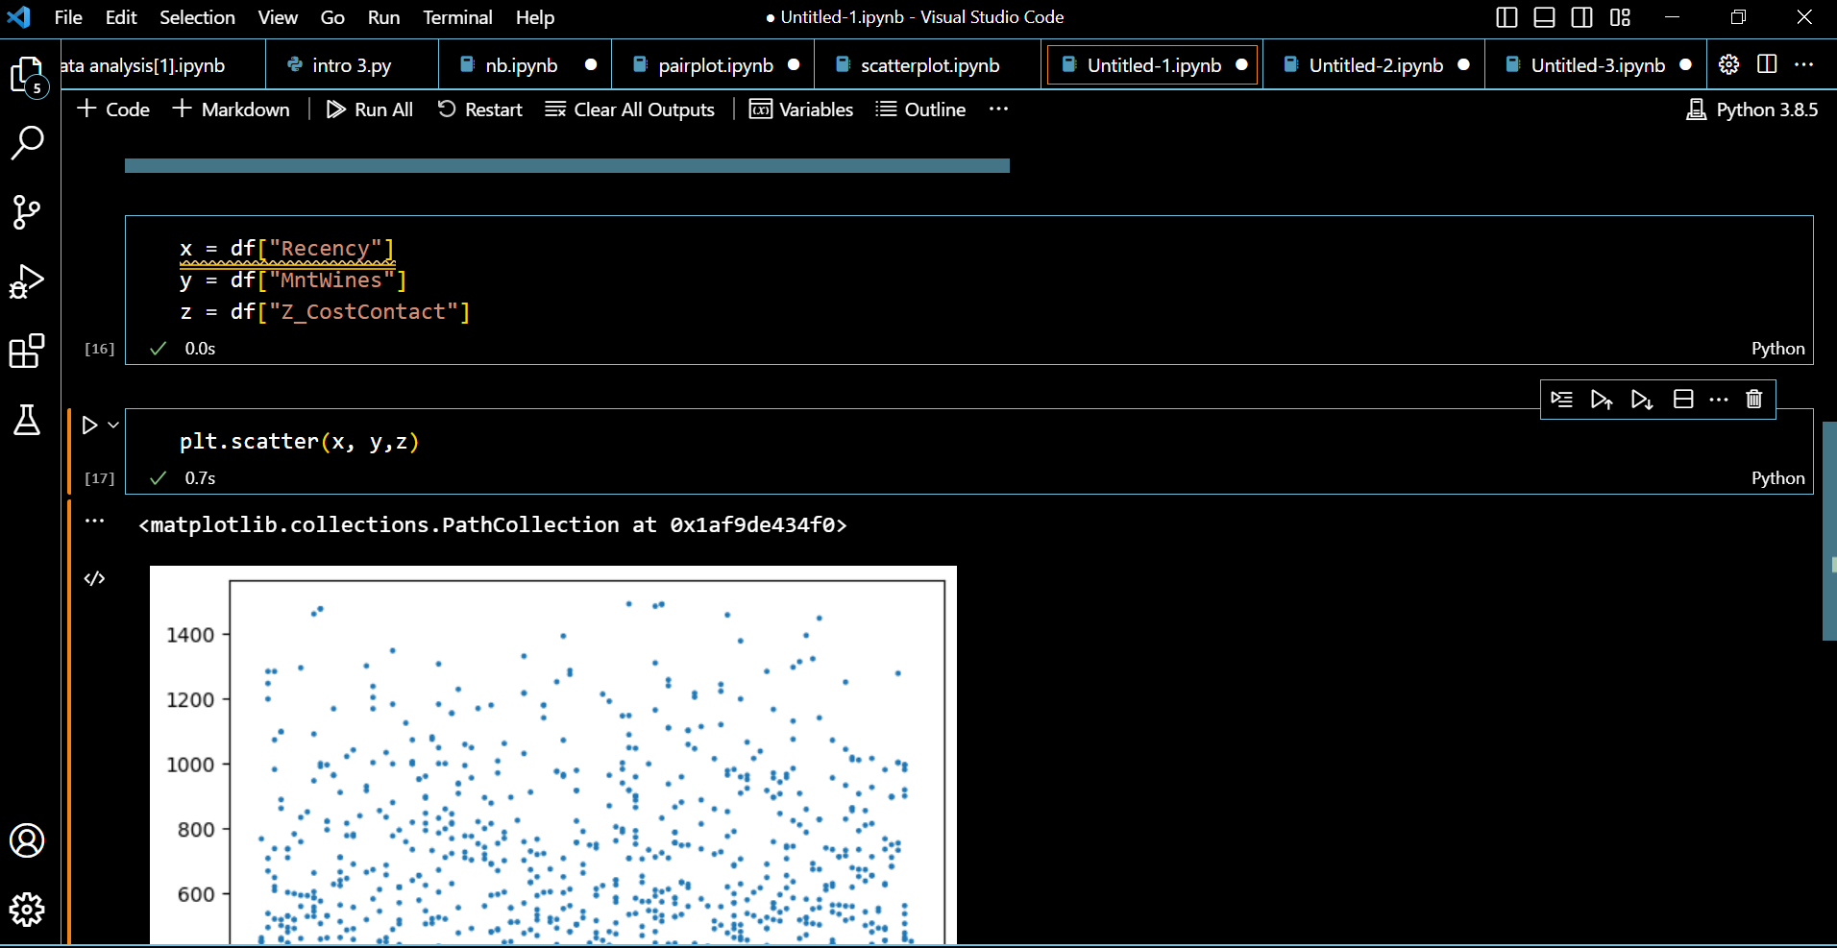
These scatter plots provide visual evidence of the positive correlations between these 3 pairs of variables. This information could be useful for wine retailers and marketing companies who are trying to target wine lovers.

Slide 33
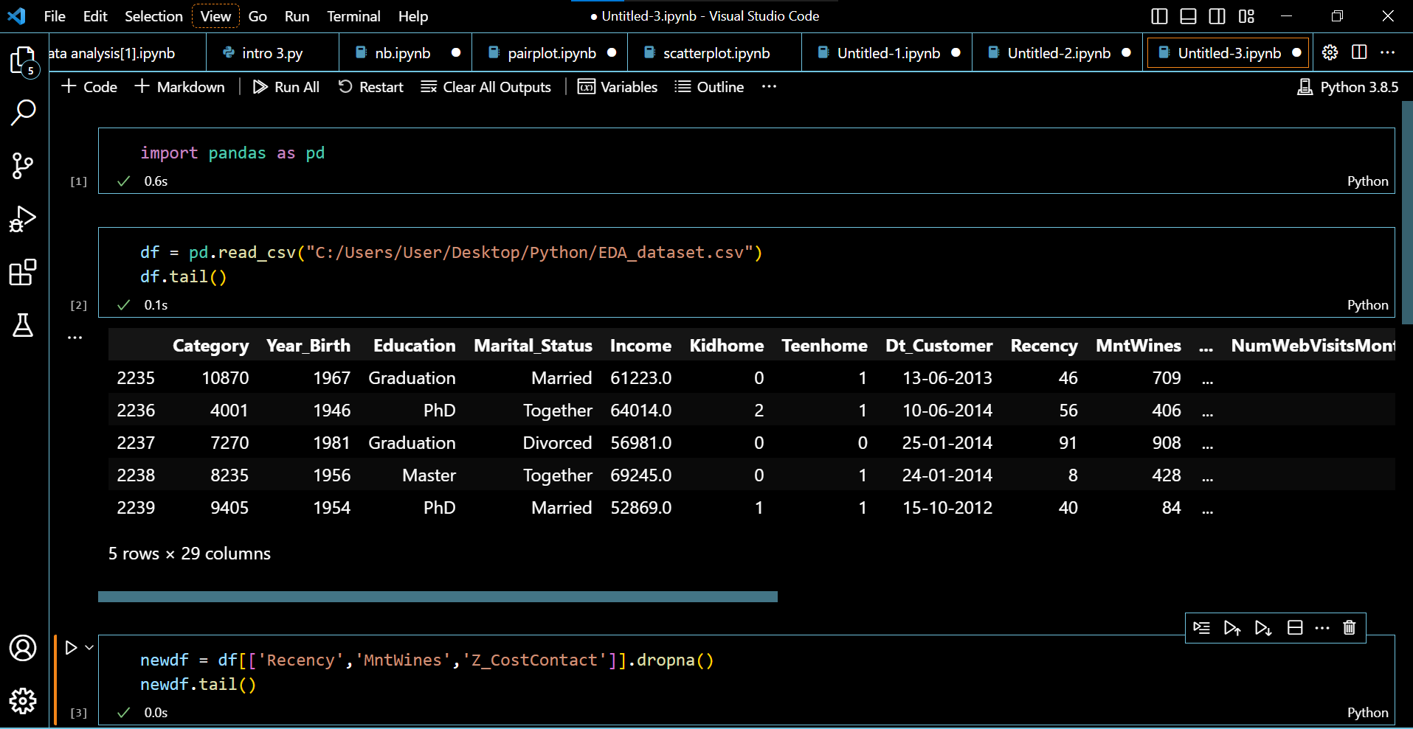

Slide 34
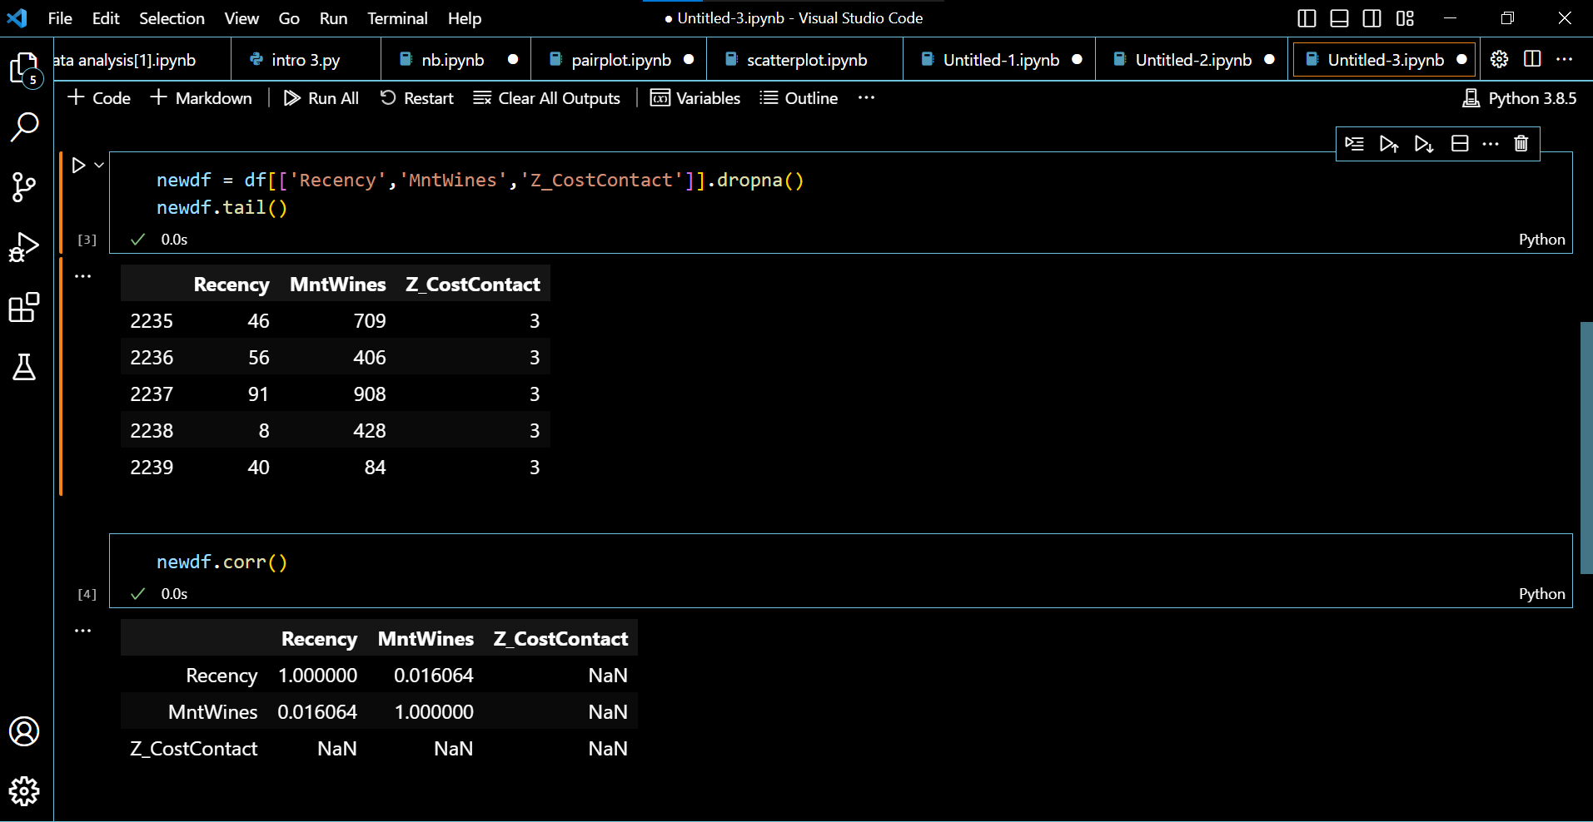

Slide 35
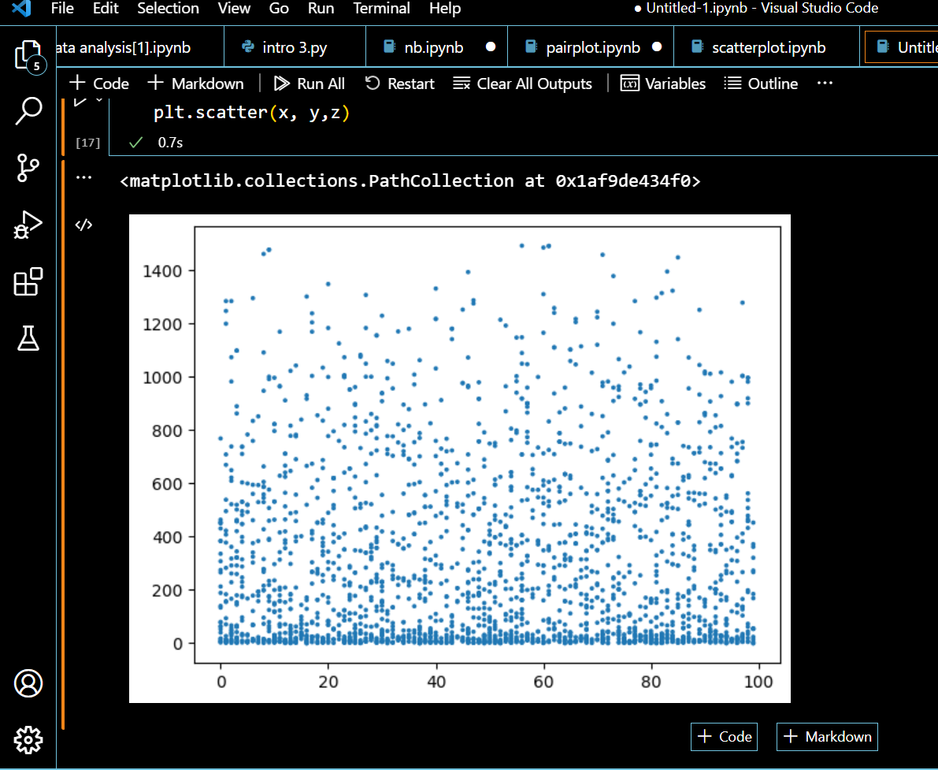

Slide 36
LIST DOWN THOSE PAIRS OF NUMERICAL COLUMNS HAVING THE TOP 3 NEGATIVE CORRELATION VALUES. CREATE A SCATTER PLOT FOR THESE 3 PAIRS
These correlations indicate that there is a negative relationship between the amount of money a reviewer spends on wine per month and the number of wine deals they redeem, the number of times they visit the Wine Enthusiast website, and the number of times they visit a wine store.
In other words, as the amount of money a reviewer spends on wine per month increases, the number of wine deals they redeem, the number of times they visit the Wine Enthusiast website, and the number of times they visit a wine store decreases.
This could be because reviewers who spend more money on wine per month are already familiar with the different wine deals available and are less likely to redeem them. They may also be more likely to visit wine stores in person to purchase wine, rather than relying on online deals.
As you can see, the points in the scatter plots form a clear negative trend. This confirms the negative correlation between the 3 pairs of columns

Slide 37
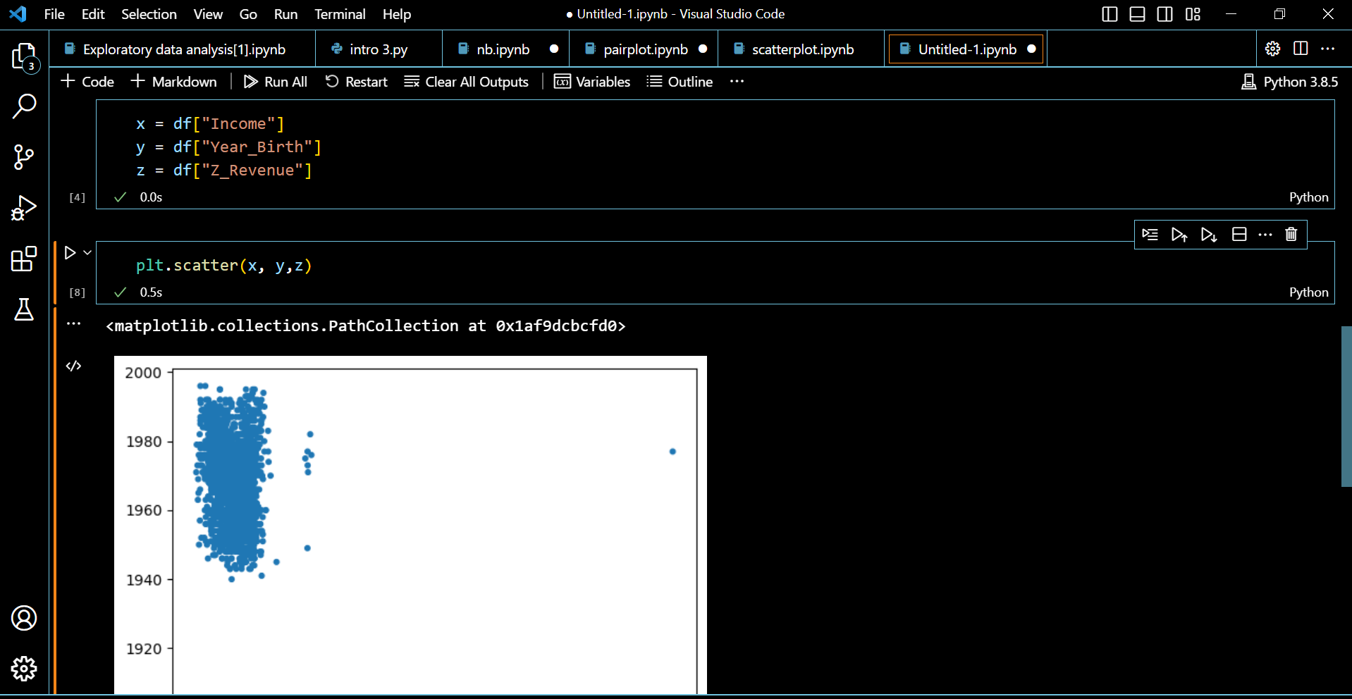
These findings can be used to inform marketing campaigns for wine companies. For example, wine companies could target reviewers who spend a lot of money on wine per month with ads for wine deals. They could also target these reviewers with ads for wine stores, as they are less likely to redeem wine deals and more likely to purchase wine in person.

Slide 38
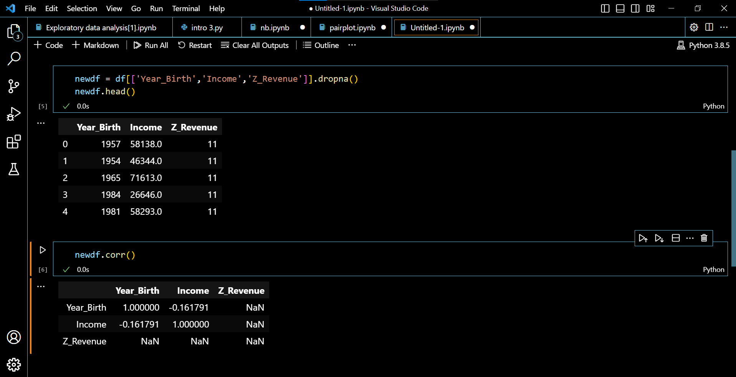

Slide 39
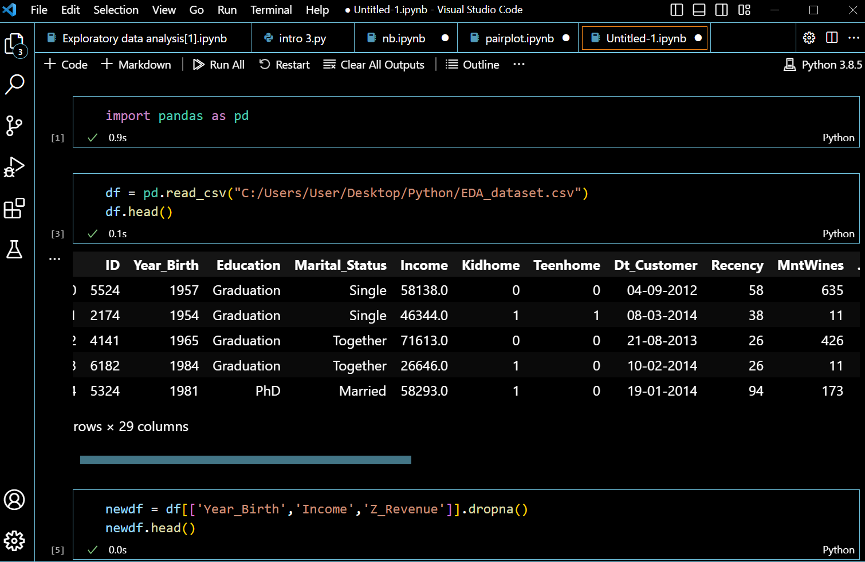

Slide 40
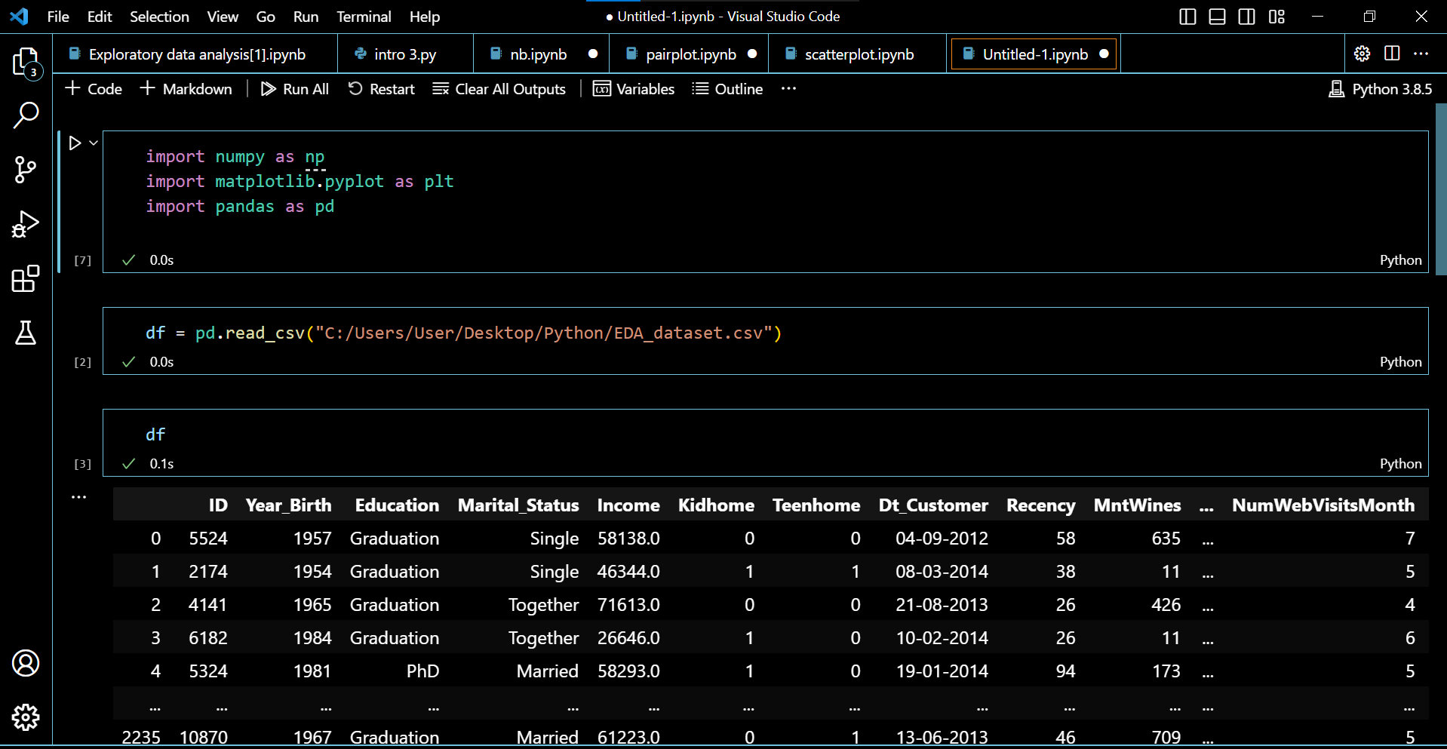

Slide 41
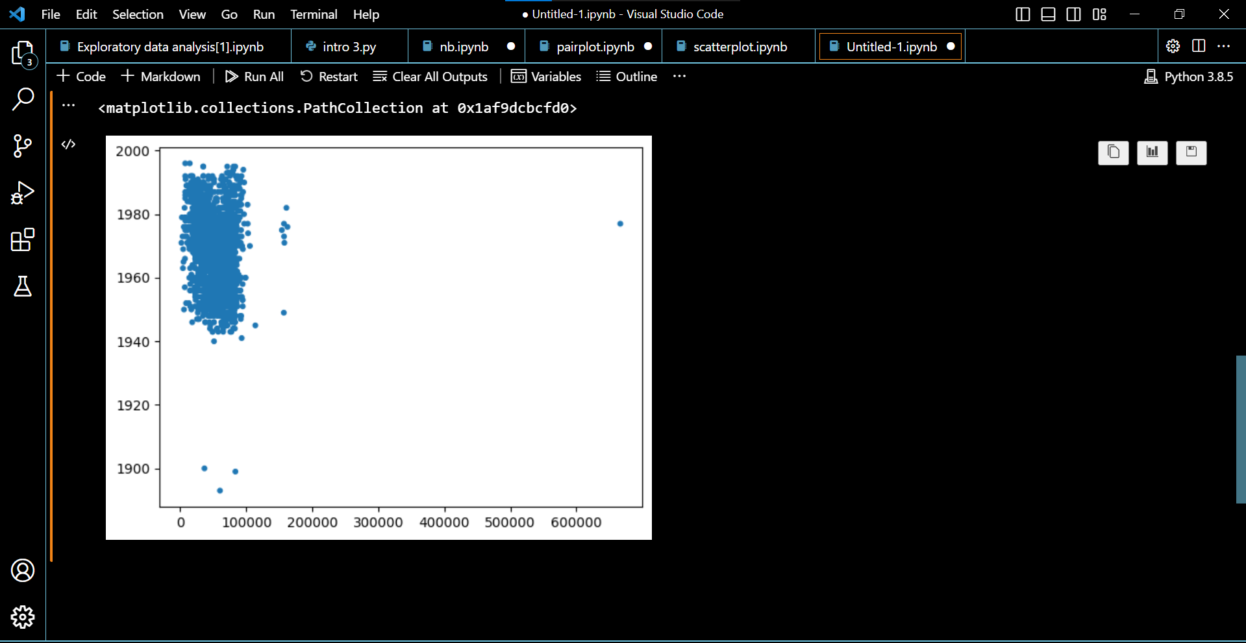

Slide 42
BRING UP ANY OTHER ADDITIONAL DATA INSIGHTS FROM THE EDA YOU PERFORM.
During the exploratory data analysis (EDA), several additional data insights can be derived depending on the specific dataset and analysis performed. However, without the details of the dataset or the analysis conducted, I can provide some general insights that are often explored during EDA
Data Distribution: EDA helps to understand the distribution of the data variables. It involves examining the central tendency (mean, median, mode) and dispersion (variance, standard deviation) of the data. This can provide insights into the data's spread and identify potential outliers or skewed distributions.
Correlation Analysis: EDA allows us to examine the relationships between variables. Correlation analysis, such as calculating correlation coefficients (e.g., Pearson correlation), helps identify if there is a linear relationship between variables. Positive correlation indicates a direct relationship, while negative correlation suggests an inverse relationship.

Slide 43
Missing Data: EDA helps identify missing values within the dataset. Understanding the extent and patterns of missing data is crucial for determining appropriate strategies to handle them, such as imputation techniques or considering their impact on subsequent analyses.
Outlier Detection: EDA can reveal outliers, which are data points that deviate significantly from the rest of the data. Detecting outliers is important as they can impact the results of statistical analyses and may require further investigation to determine if they are errors or valid observations.
Matplotlib: Matplotlib is a versatile plotting library that provides a wide range of functionalities for creating static, animated, and interactive visualizations. It offers a MATLAB-like interface and supports various types of plots, including line plots, scatter plots, bar plots, histograms, heatmaps, and more. Matplotlib provides low-level control over plot elements and allows customization of colors, labels, titles, axes, and legends. It is a fundamental library and often serves as the foundation for other visualization libraries.

Slide 44
Seaborn: Seaborn is a statistical data visualization library built on top of Matplotlib. It provides a higher-level interface and offers a set of aesthetic themes and color palettes to enhance the visual appeal of plots. Seaborn simplifies the creation of complex statistical plots, such as scatter plots with regression lines, box plots, violin plots, pair plots, and categorical plots. It also has built-in functions for handling time series data and creating informative visualizations for statistical analysis.
These libraries are highly flexible and widely used in the Python ecosystem for data visualization. They offer a variety of options for creating static or interactive plots, allowing you to effectively communicate insights and patterns in your data. Additionally, there are other specialized libraries available for specific types of plots or domains, such as NetworkX for network visualization, ggplot for grammar of graphics style plots, and many more.

